Slide 1
Chapter 4: Implementing Firewall Technologies
CCNA Security v2.0

Slide 2
Chapter Outline
4.0 Introduction
4.1 Access Control Lists
4.2 Firewall Technologies
4.3 Zone-Based Policy Firewalls
4.4 Summary

Slide 3
Section 4.1: Access Control List
Upon completion of this section, you should be able to:
Configure standard and extended IPv4 ACLs using CLI.
Use ACLs to mitigate common network attacks.
Configure IPv6 ACLs using CLI.

Slide 4
Topic 4.1.1: Configuring Standard and Extended IPv4 ACLs with CLI

Slide 5
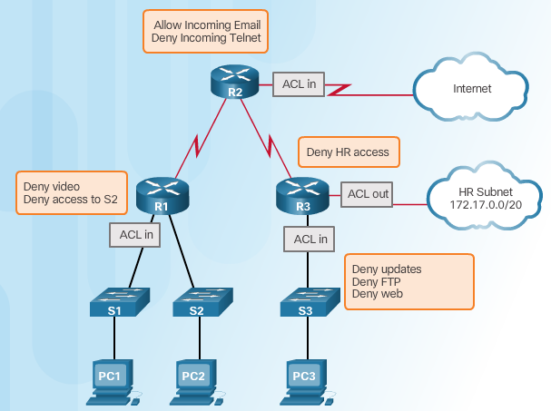
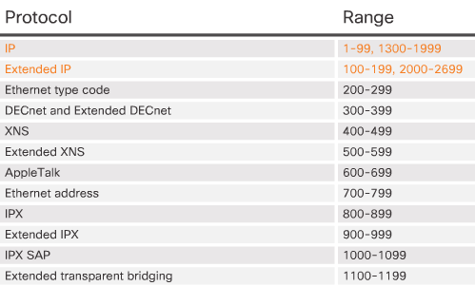
Introduction to Access Control Lists
Notes:
4.1.1.1 Introduction to Access Control Lists

Slide 6
Configuring Numbered and Named ACLs
Standard Numbered ACL Syntax
Extended Numbered ACL Syntax
Named ACL Syntax
Standard ACE Syntax
Extended ACE Syntax
Notes:
4.1.1.2 Configuring Numbered and Named ACLs

Slide 7
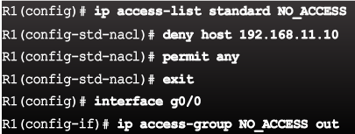
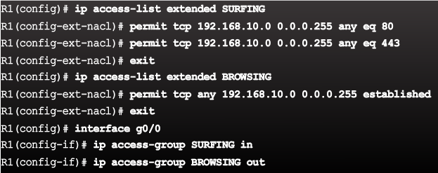
Applying an ACL
Syntax - Apply an ACL to an interface
Syntax - Apply an ACL to the VTY lines
Example - Named Standard ACL
Example - Named Extended ACL
Notes:
4.1.1.3 Applying an ACL

Slide 8
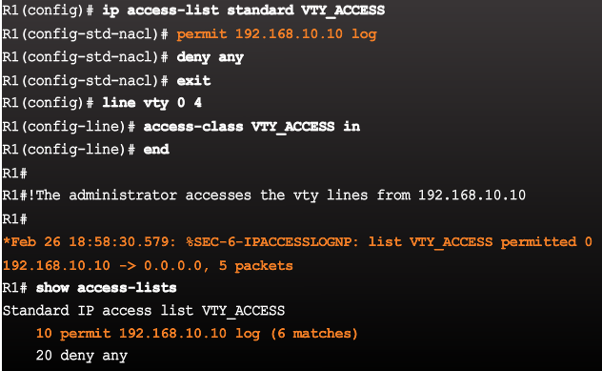
Applying an ACL (Cont.)
Syntax - Apply an ACL to the VTY lines
Example - Named ACL on VTY lines with logging
Notes:
4.1.1.3 Applying an ACL

Slide 9
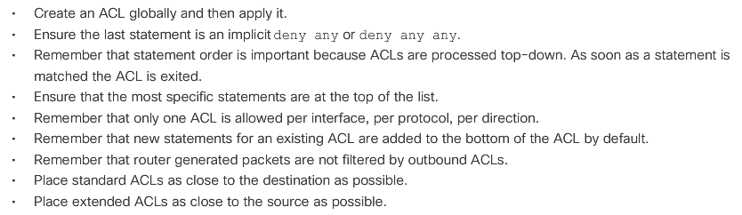
ACL Configuration Guidelines
Notes:
4.1.1.4 ACL Configuration Guidelines

Slide 10
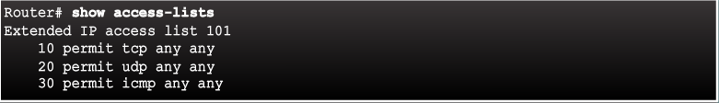

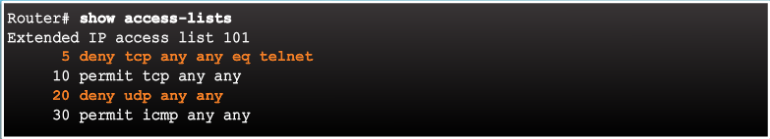
Editing Existing ACLs
Existing access list has three entries
Access list has been edited, which adds a new ACE and replaces ACE line 20.
Updated access list has four entries
Notes:
4.1.1.5 Editing Existing ACLs

Slide 11
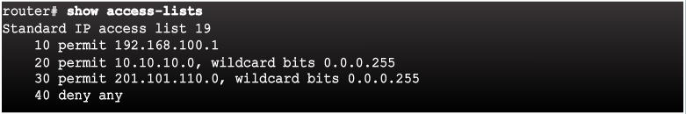
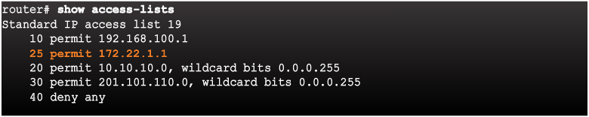
Sequence Numbers and Standard ACLs
Existing access list has four entries
Access list has been edited, which adds a new ACE that permits a specific IP address.
Updated access list places the new ACE before line 20
Notes:
4.1.1.6 Sequence Numbers and Standard ACLs
4.1.1.7 Activity - Configure Standard ACLs
4.1.1.8 Activity - Create an Extended ACL Statement
4.1.1.9 Activity - Evaluate Extended ACL Statements
4.1.1.10 Packet Tracer - Configure Extended ACLs Scenario 1
4.1.1.11 Packet Tracer - Configure Extended ACLs Scenario 2

Slide 12
Topic 4.1.2: Mitigating Attacks with ACLs

Slide 13
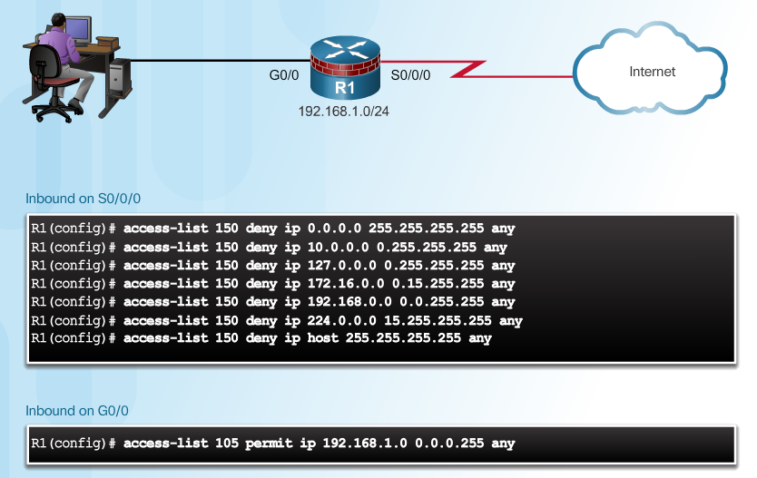
Antispoofing with ACLs
Notes:
4.1.2.1 Antispoofing with ACLs

Slide 14
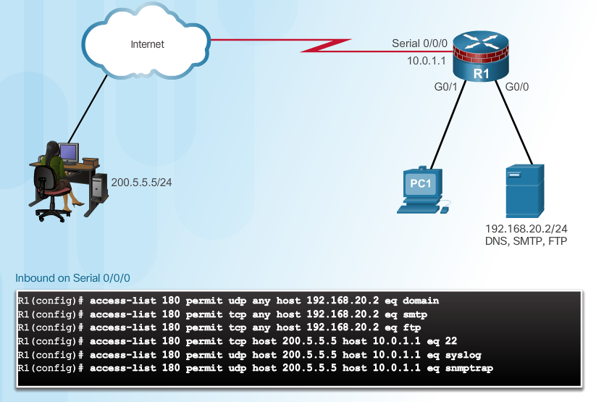
Permitting Necessary Traffic through a Firewall
Notes:
4.1.2.2 Permitting Necessary Traffic through a Firewall

Slide 15
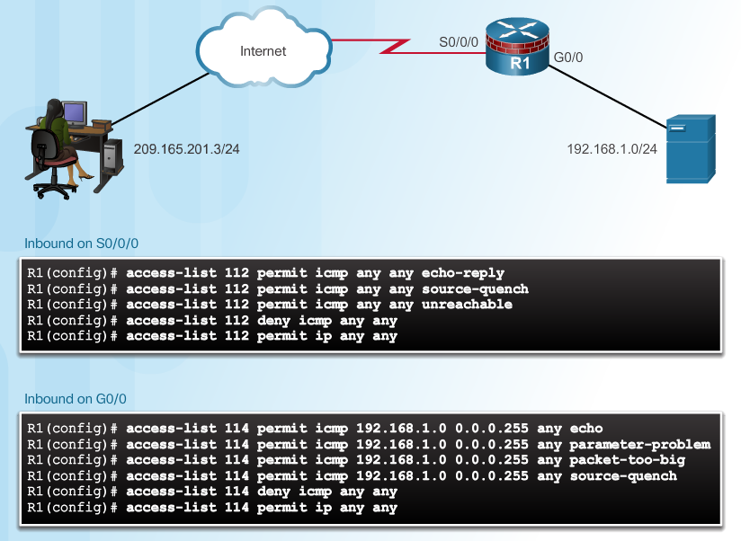
Mitigating ICMP Abuse
Notes:
4.1.2.3 Mitigating ICMP Abuse

Slide 16
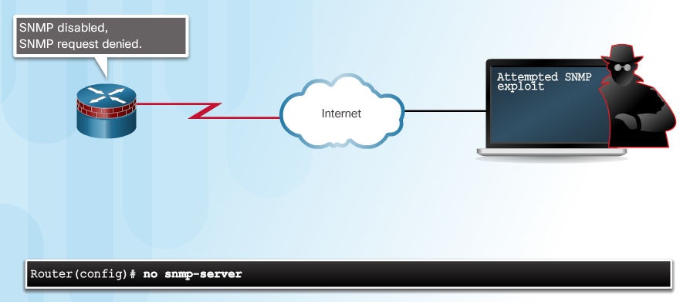
Mitigating SNMP Exploits
Notes:
4.1.2.4 Mitigating SNMP Exploits
4.1.2.5 Packet Tracer - Configure IP ACLs to Mitigate Attacks

Slide 17
Topic 4.1.3: IPv6 ACLs

Slide 18
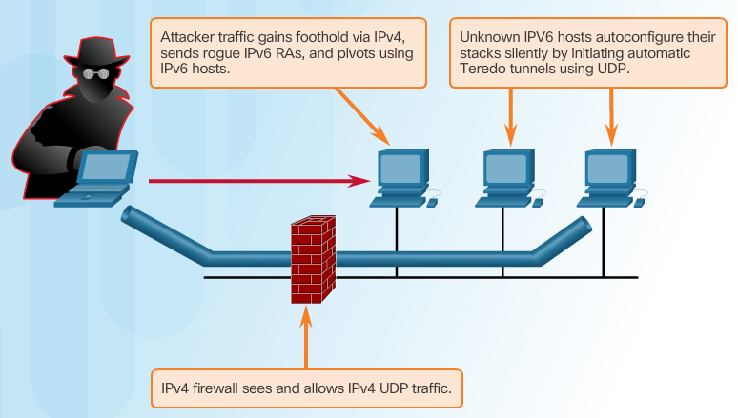
Introducing IPv6 ACLs
Notes:
4.1.3.1 Introducing IPv6 ACLs

Slide 19
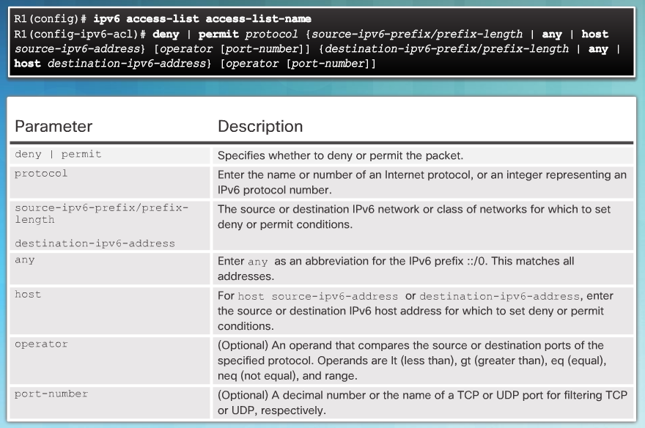
IPv6 ACL Syntax
Notes:
4.1.3.2 IPv6 ACL Syntax

Slide 20
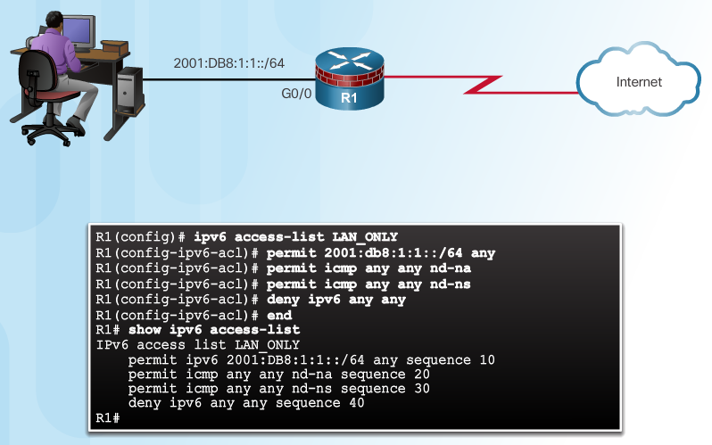
Configure IPv6 ACLs
Notes:
4.1.3.3 Configure IPv6 ACLs
4.1.3.4 Packet Tracer - Configure IPv6 ACLs

Slide 21
Section 4.2: Firewall Technologies
Upon completion of this section, you should be able to:
Explain how firewalls are used to help secure networks.
Describe the various types of firewalls.
Configure a classic firewall.
Explain design considerations for implementing firewall technologies.

Slide 22
Topic 4.2.1: Securing Networks with Firewalls

Slide 23
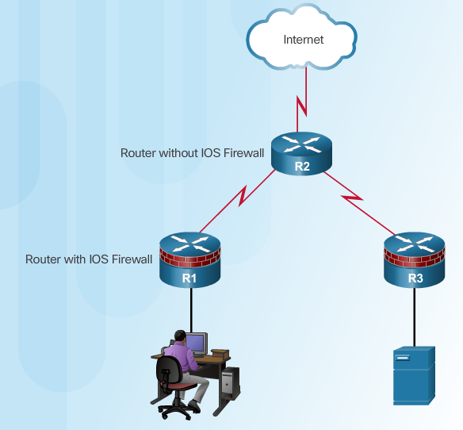
Defining Firewalls
All firewalls:
Are resistant to attack
Are the only transit point between networks because all traffic flows through the firewall
Enforce the access control policy
Notes:
4.2.1.1 Defining Firewalls

Slide 24
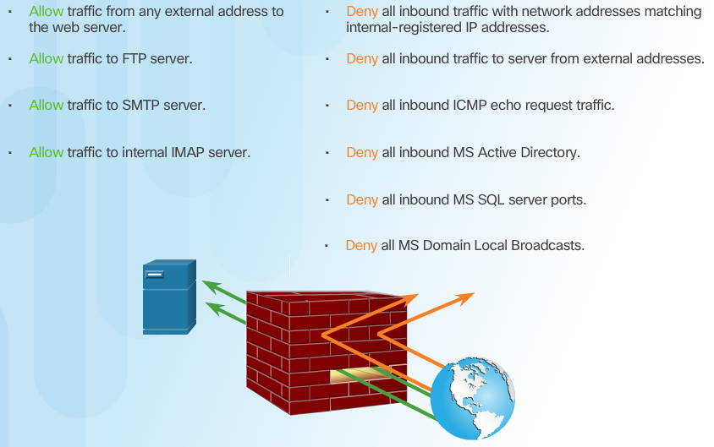
Benefits and Limitations of Firewalls
Notes:
4.2.1.2 Benefits and Limitations of Firewalls

Slide 25
Topic 4.2.2: Types of Firewalls

Slide 26
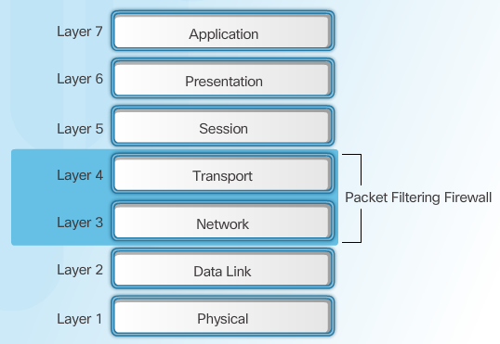
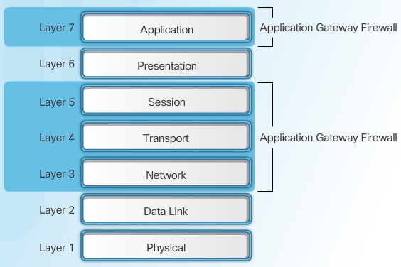
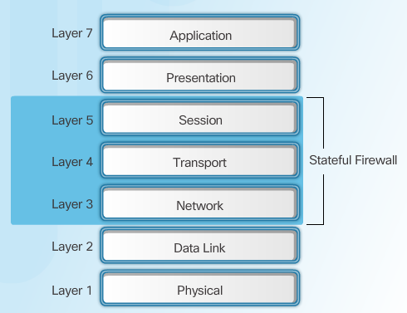
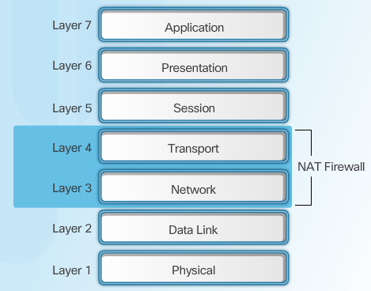
Firewall Type Descriptions
Packet Filtering Firewall
Application Gateway Firewall
Stateful Firewall
NAT Firewall
Notes:
4.2.2.1 Firewall Type Descriptions

Slide 27
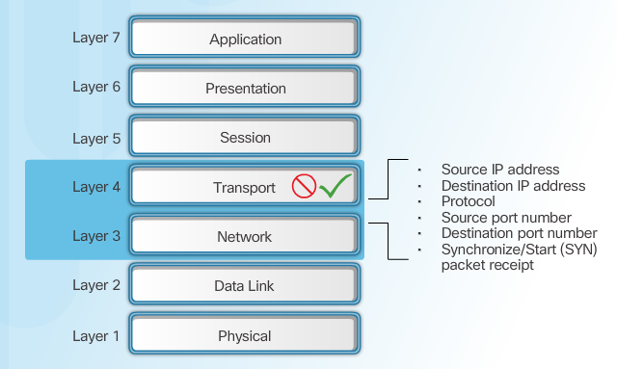
Packet Filtering Firewall Benefits & Limitations
Notes:
4.2.2.2 Packet Filtering Firewall Benefits and Limitations

Slide 28
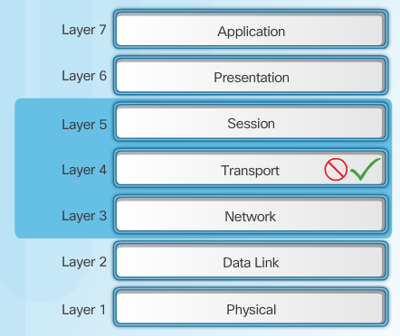
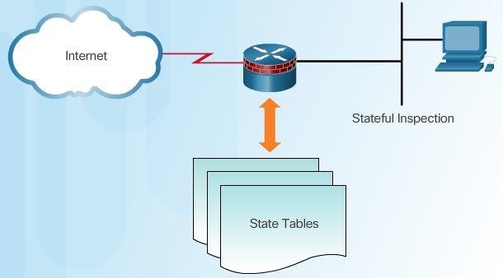
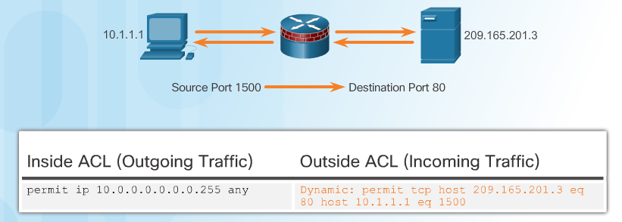
Stateful Firewalls
Stateful Firewalls
State Tables
Stateful Firewall Operation
Notes:
4.2.2.3 Stateful Firewalls

Slide 29
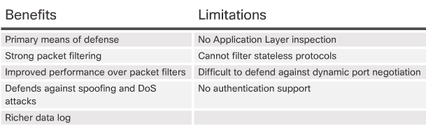
Stateful Firewall Benefits and Limitations
Next Generation Firewalls
Granular identification, visibility, and control of behaviors within applications
Restricting web and web application use based on the reputation of the site
Proactive protection against Internet threats
Enforcement of policies based on the user, device, role, application type, and threat profile
Performance of NAT, VPN, and SPI
Use of an IPS
Notes:
4.2.2.4 Stateful Firewall Benefits and Limitations
4.2.2.5 Next Generation Firewalls
4.2.2.6 Video Tutorial - Cisco ASA with FirePOWER Services
4.2.2.7 Activity - Identify the Type of Firewall

Slide 30
Topic 4.2.3: Classic Firewall

Slide 31
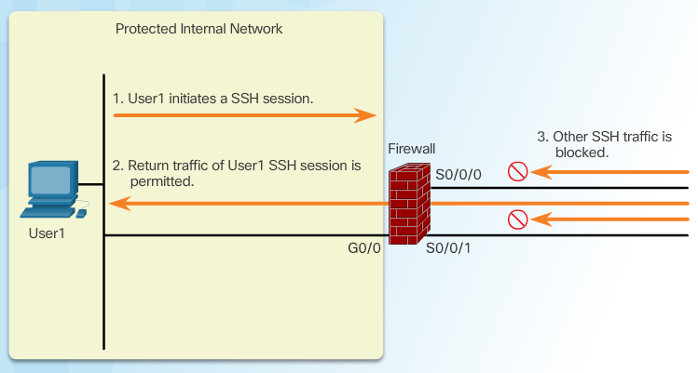
Introducing Classic Firewall
Notes:
4.2.3.1 Introducing Classic Firewall

Slide 32
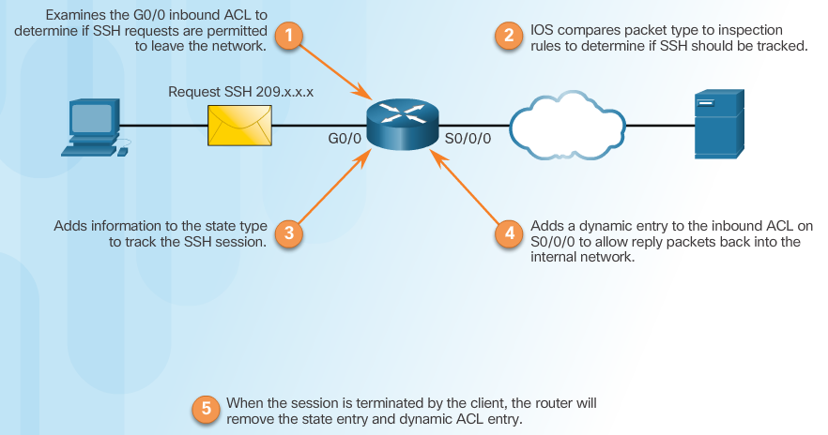
Classic Firewall Operation
Notes:
4.2.3.2 Classic Firewall Operation

Slide 33
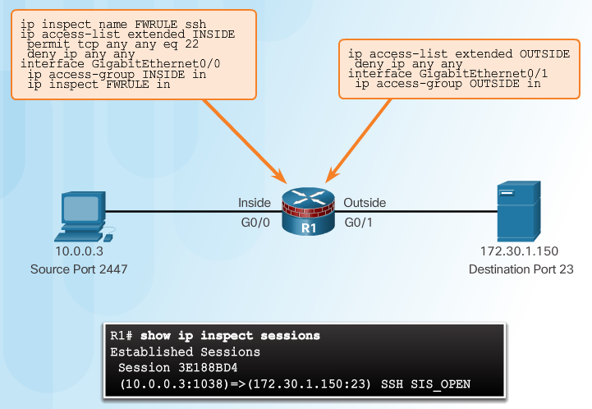
Classic Firewall Configuration
Choose the internal and external interfaces.
Configure ACLs for each interface.
Define inspection rules.
Apply an inspection rule to an interface.
Inspection Rules
Notes:
4.2.3.3 Classic Firewall Configuration

Slide 34
Topic 4.2.4: Firewalls in Network Design

Slide 35
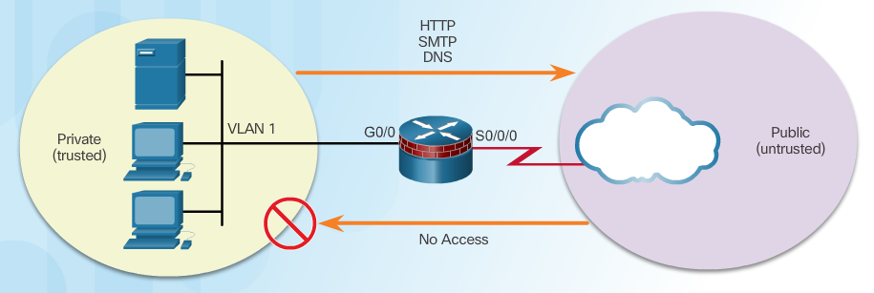
Inside and Outside Networks
Notes:
4.2.4.1 Inside and Outside Networks

Slide 36
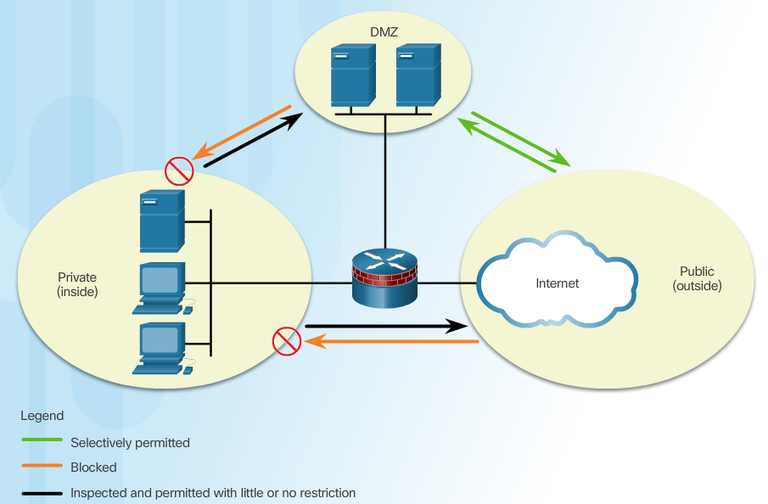
Demilitarized Zones
Notes:
4.2.4.2 Demilitarized Zones

Slide 37
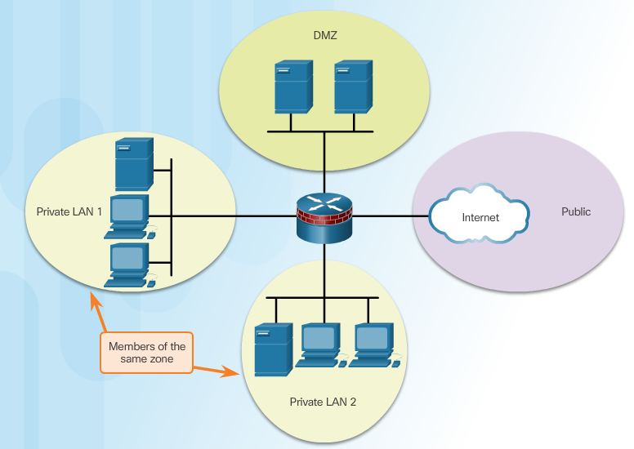
Zone-Based Policy Firewalls
Notes:
4.2.4.3 Zone-Based Policy Firewalls

Slide 38
Layered Defense
Considerations for network defense:
Network core security
Perimeter security
Endpoint security
Communications security
Firewall best practices include:
Position firewalls at security boundaries.
It is unwise to rely exclusively on a firewall for security.
Deny all traffic by default. Permit only services that are needed.
Ensure that physical access to the firewall is controlled.
Monitor firewall logs.
Practice change management for firewall configuration changes.
Remember that firewalls primarily protect from technical attacks originating from the outside.
Notes:
4.2.4.4 Layered Defense

Slide 39
Section 4.3: Zone-Based Policy Firewalls
Upon completion of this section, you should be able to:
Explain how Zone-Based Policy Firewalls are used to help secure a network.
Explain the operation of a Zone-Based Policy Firewall.
Configure a Zone-Based Policy Firewall with CLI.

Slide 40
Topic 4.3.1: Zone-Based Policy Firewall Overview

Slide 41
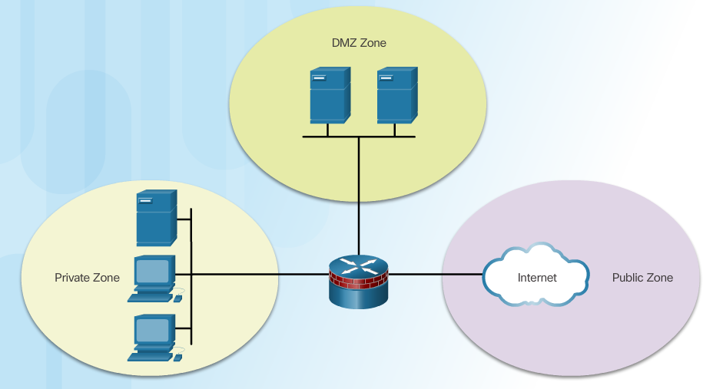
Benefits of ZPF
Not dependent on ACLs
Router security posture is to block unless explicitly allowed
Policies are easy to read and troubleshoot with C3PL
One policy affects any given traffic, instead of needing multiple ACLs and inspection actions
Notes:
4.3.1.1 Benefits of ZPF

Slide 42
ZPF Design
Common designs include:
LAN-to-Internet
Firewalls between public servers
Redundant firewalls
Complex firewalls
Design steps:
Determine the zones
Establish policies between zones
Design the physical infrastructure
Identify subsets within zones and merge traffic requirements
Notes:
4.3.1.2 ZPF Design
4.3.1.3 Activity - Compare Classic Firewall and ZPF Operation

Slide 43
Topic 4.3.2: ZPF Operation

Slide 44
ZPF Actions
Inspect - Configures Cisco IOS stateful packet inspections.
Drop - Analogous to a deny statement in an ACL. A log option is available to log the rejected packets.
Pass - Analogous to a permit statement in an ACL. The pass action does not track the state of connections or sessions within the traffic.
Notes:
4.3.2.1 ZPF Actions

Slide 45
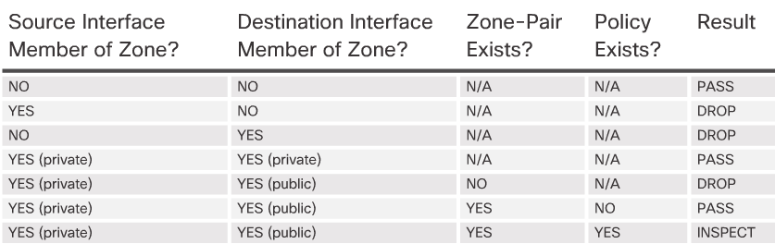
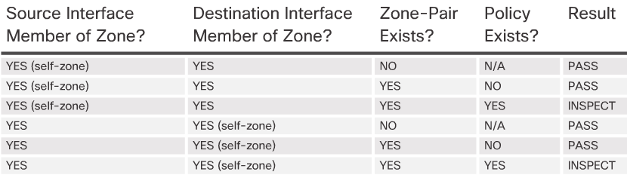
Rules for Transit Traffic
Rules for Traffic to the Self Zone
Notes:
4.3.2.2 Rules for Transit Traffic
4.3.2.3 Rules for Traffic to the Self Zone
4.3.2.4 Activity - Rules for Transit Traffic

Slide 46
Topic 4.3.3: Configuring a ZPF

Slide 47
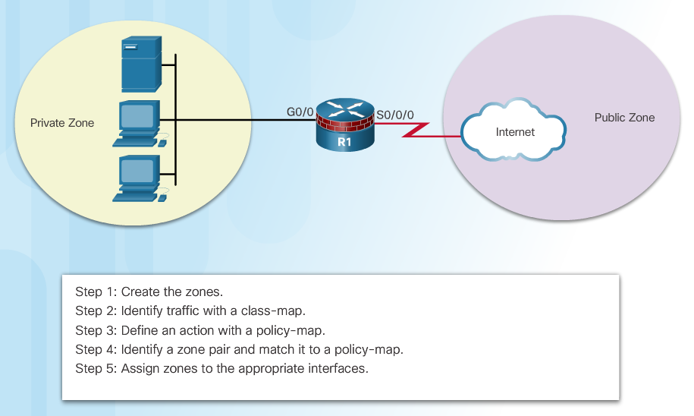
Configure ZPF
Notes:
4.3.3.1 Configure ZPF

Slide 48
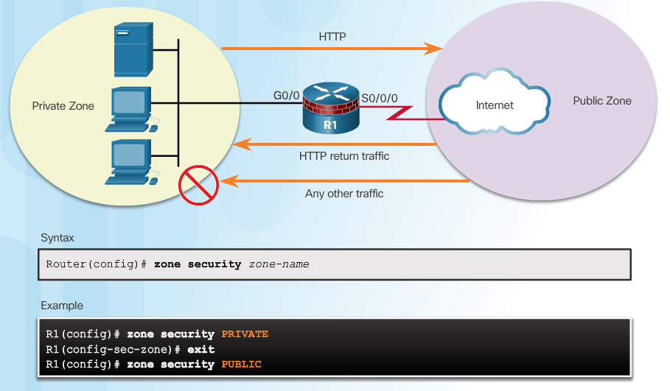
Step 1: Create Zones
Notes:
4.3.3.2 Create Zones

Slide 49
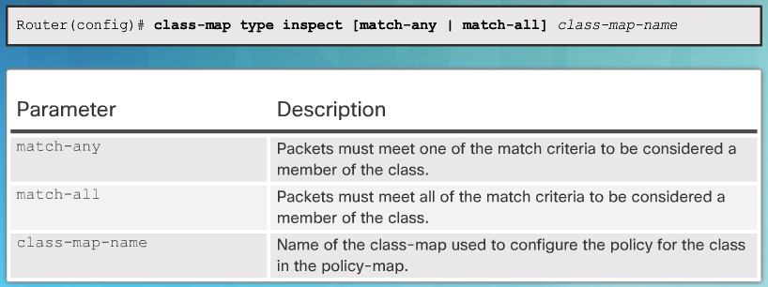
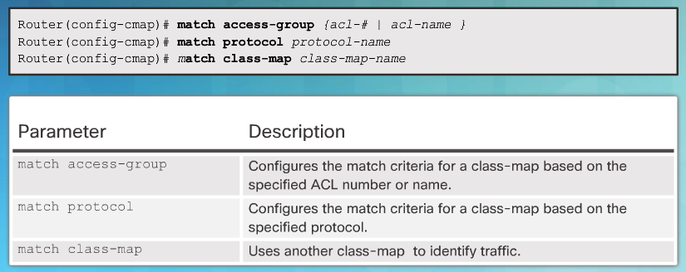
Step 2: Identify Traffic
Command Syntax for class-map
Sub-Configuration Command Syntax for class-map
Notes:
4.3.3.3 Identify Traffic

Slide 50
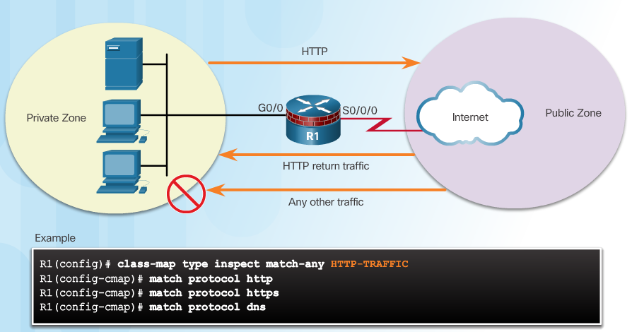
Step 2: Identify Traffic (Cont.)
Example class-map Configuration
Notes:
4.3.3.3 Identify Traffic

Slide 51
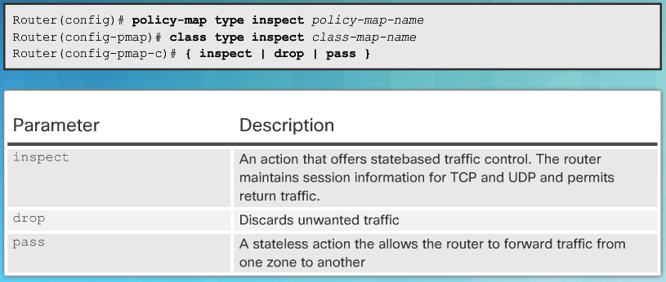
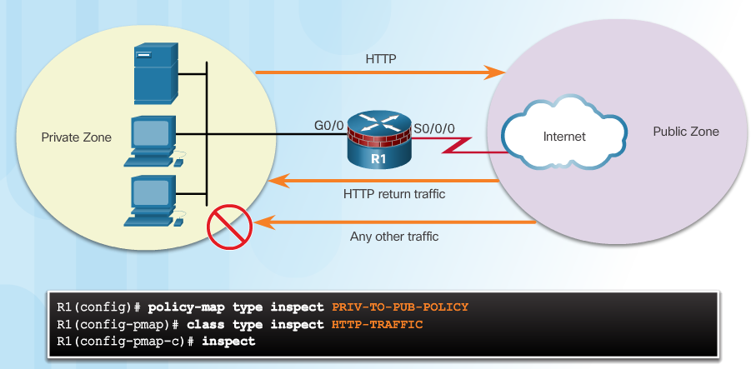
Step 3: Define an Action
Command Syntax for policy-map
Example policy-map Configuration
Notes:
4.3.3.4 Define an Action

Slide 52
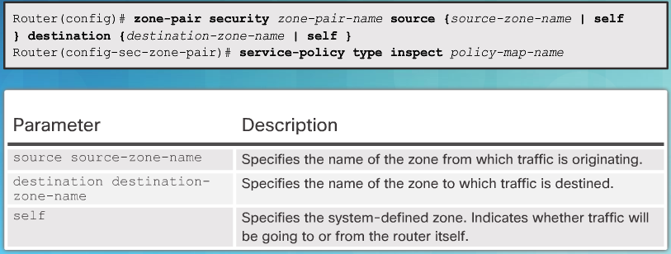
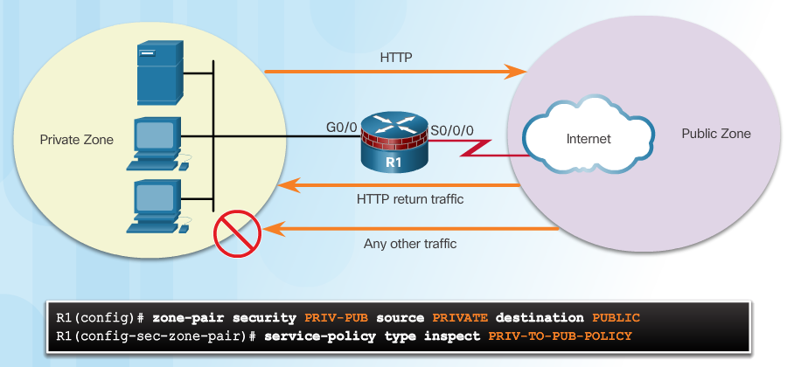
Step 4: Identify a Zone-Pair and Match to a Policy
Command Syntax for zone-pair and service-policy
Example service-policy Configuration
Notes:
4.3.3.5 Identify a Zone-Pair and Match to a Policy

Slide 53
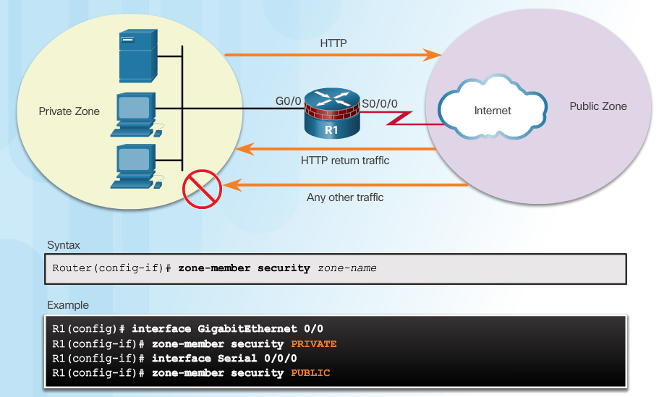
Step 5: Assign Zones to Interfaces
Notes:
4.3.3.6 Assign Zones to Interfaces

Slide 54
Verify a ZPF Configuration
Verification commands:
show run | begin class-map
show policy-map type inspect zone-pair sessions
show class-map type inspect
show zone security
show zone-pair security
show policy-map type inspect
ZPF Configuration Considerations
No filtering is applied for intra-zone traffic
Only one zone is allowed per interface.
No Classic Firewall and ZPF configuration on same interface.
If only one zone member is assigned, all traffic is dropped.
Only explicitly allowed traffic is forwarded between zones.
Traffic to the self zone is not filtered.
Notes:
4.3.3.7 Verify a ZPF Configuration
Syntax Checker - Configure Zone-Based Policy Firewall with CLI
4.3.3.8 ZPF Configuration Considerations
4.3.3.9 Video Demonstration - ZPFs

Slide 55
Section 4.4: Summary
Chapter Objectives:
Implement ACLs to filter traffic and mitigate network attacks on a network.
Configure a classic firewall to mitigate network attacks.
Implement ZPF using CLI.
Notes:
4.4.1.1 Packet Tracer - Configuring a ZPF
4.4.1.2 Lab - Configuring ZPFs
4.4.1.3 Summary

Slide 57
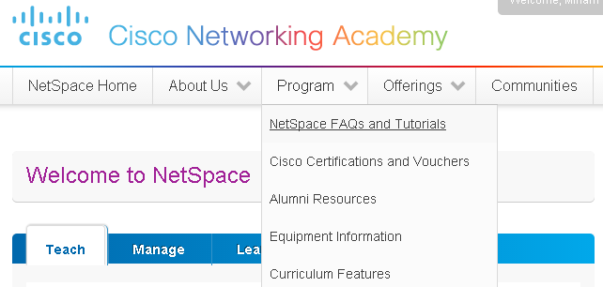
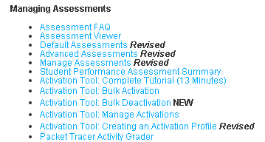
Instructor Resources
Remember, there are helpful tutorials and user guides available via your NetSpace home page. (https://www.netacad.com)
These resources cover a variety of topics including navigation, assessments, and assignments.
A screenshot has been provided here highlighting the tutorials related to activating exams, managing assessments, and creating quizzes.
1
2
Notes:
https://www.netacad.com

